Slide 1
Dongguan Ganyuan Hardware Technology Co., Ltd.
东莞市赣源五金科技有限公司

Slide 2
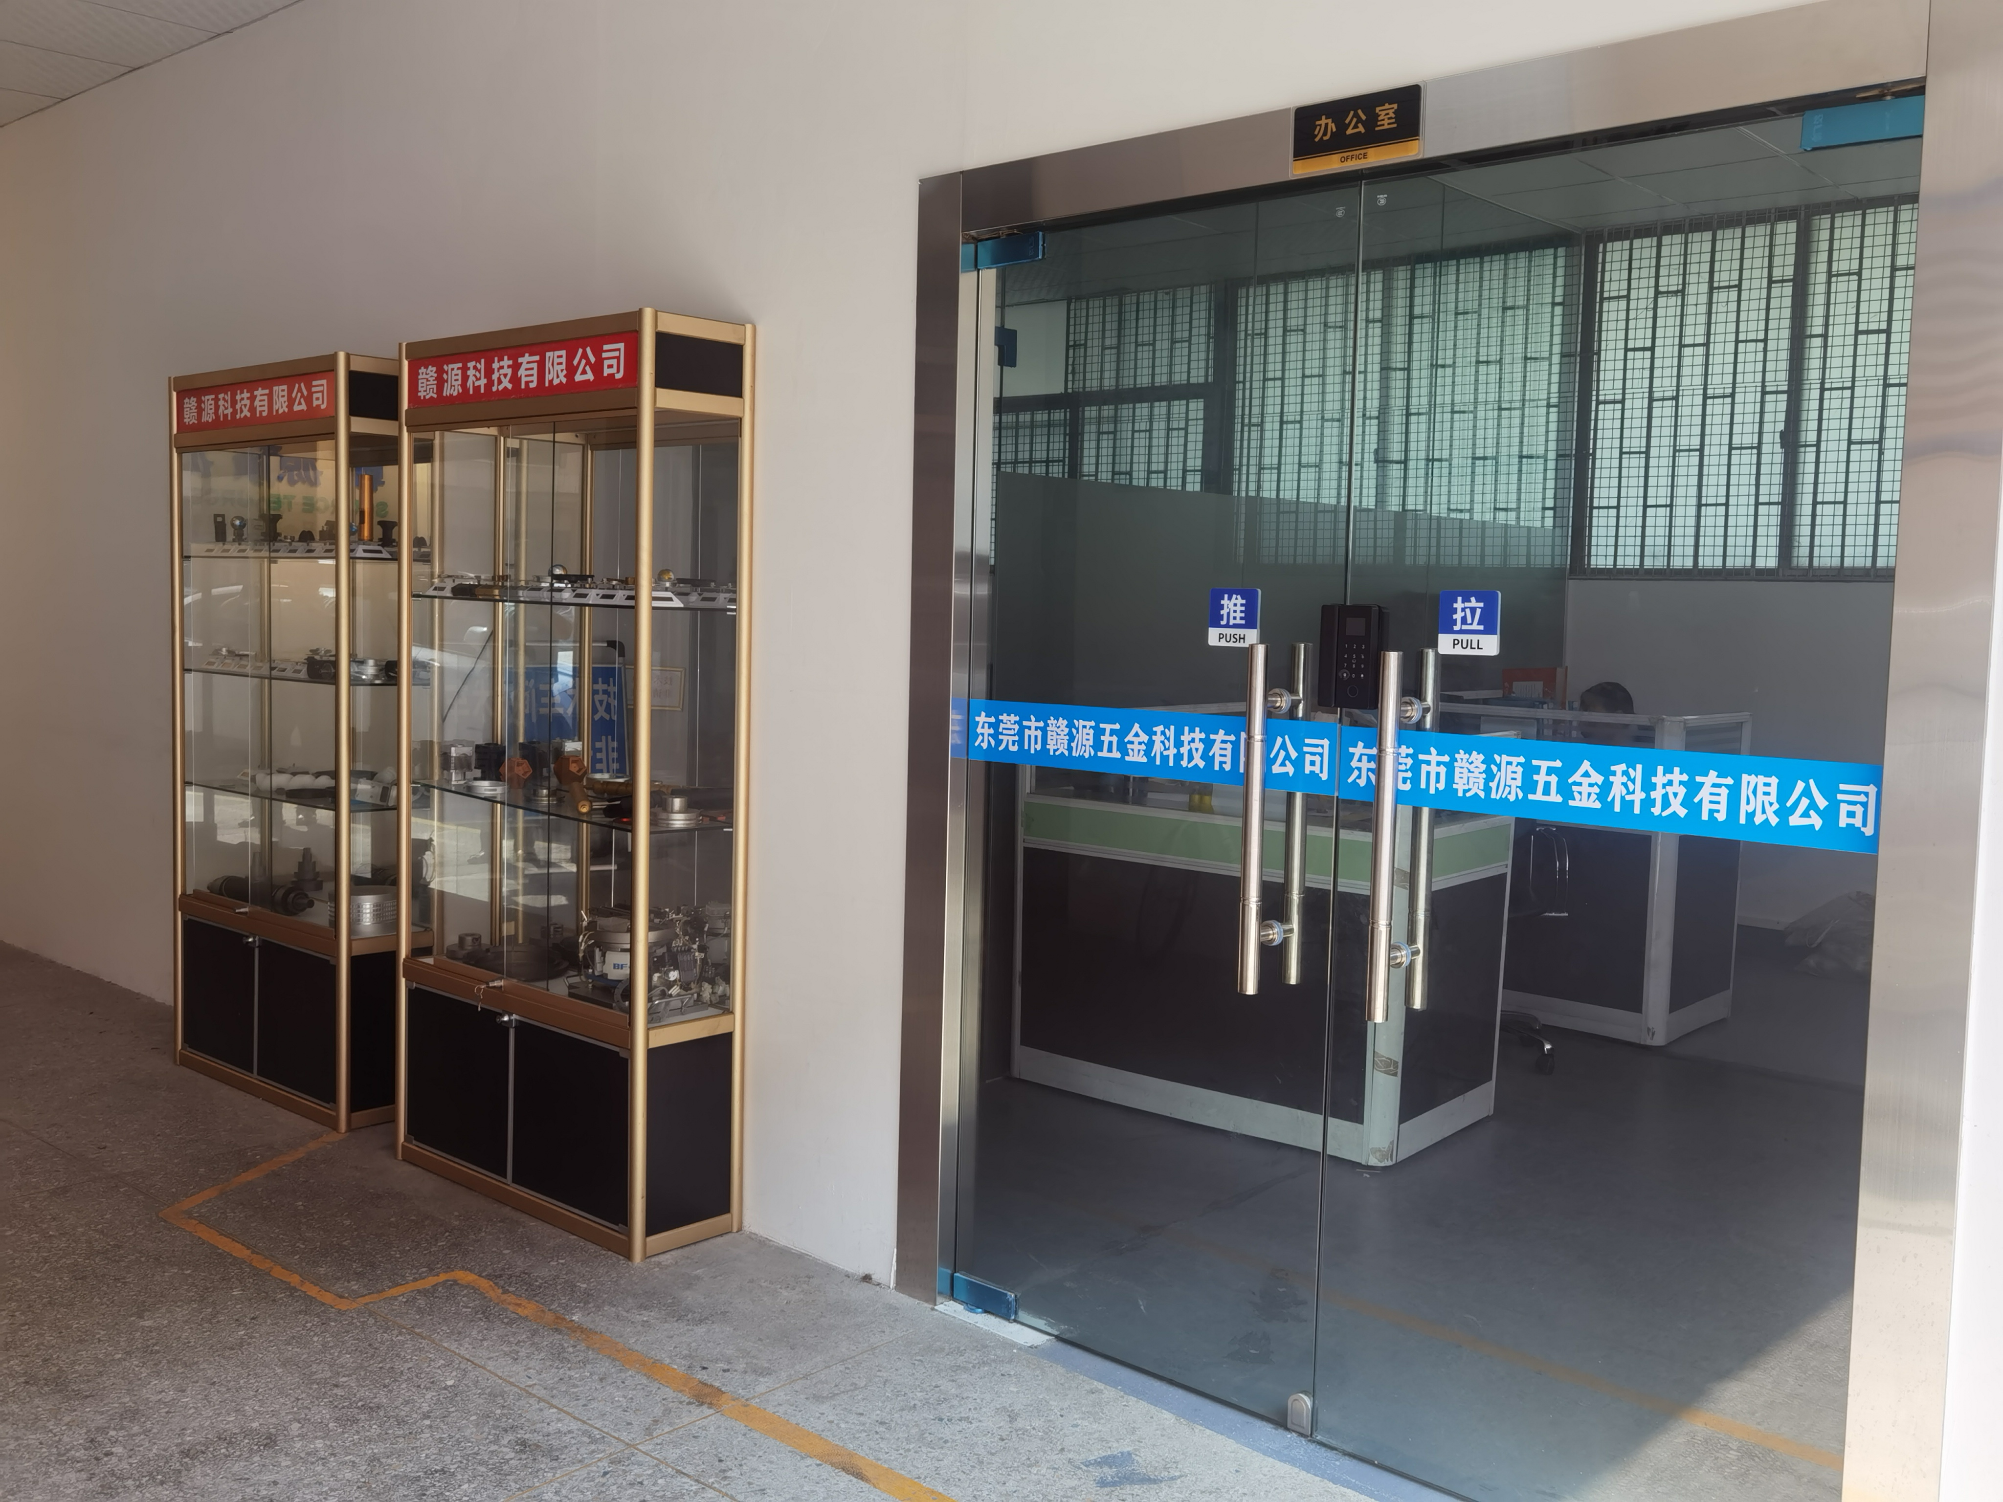
Company Profile公司简介
Dongguan Ganyuan Hardware Technology Co., Ltd.
Dongguan Ganyuan Hardware Technology Co., Ltd. is an entity manufacturing factory with more than 20 years of experience in CNC machining technology. It is located in Dongguan City, Guangdong Province, China. It is committed to innovative R&D and production. High-quality technical management personnel and experienced designers, R&D personnel, and perfect company management system.
The company has its own brand and masters the high-end production core technology. Has advanced precision production equipment: CNC numerical control lathe, five-axis CNC machining center; five-axis CNC drilling and tapping center, five-axis CNC engraving and milling machine, surface grinder, internal and external cylindrical grinding, slow wire walking, wire cutting and other high-precision equipment ; Testing equipment: advanced three-dimensional, precision two-dimensional, projector and some conventional testing equipment.
The company adheres to the business philosophy of the spirit of craftsmanship and adheres to the principle of "quality assurance, mutual benefit, and win-win cooperation" to provide our customers with high-quality quality and services. Welcome OEM and ODM orders to join, and welcome to send emails and drawings to negotiate and cooperate. ,thanks!
Email: ganyuancnc@163.com Website: https://www.ganyuan.net
Mobile: 86-13929256361 QQ:362027810 Contact: Mr. Liao
Factory Address: 1st Floor, Building A, No. 78, Yintong Road, Shuikou Industrial Zone, Dalang Town, Dongguan City, Guangdong Province, China
赣源五金

Slide 3
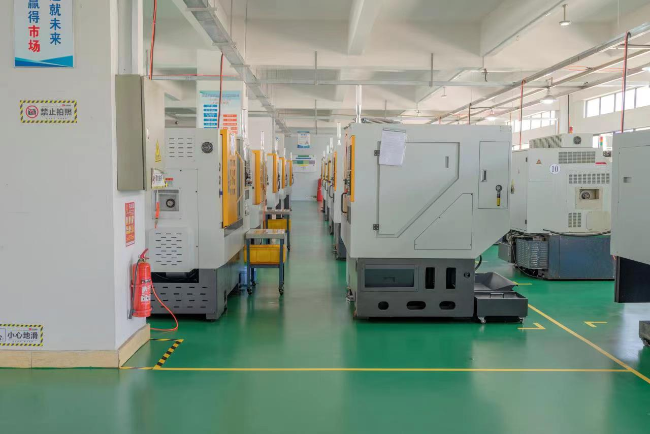
CNC lathe workshop
The company has more than 40 high-end precision CNC lathes, another 10 turn-milling machines, 5 automatic lathes, etc., professional external processing, 15 years of factory, more than 20 years of processing experience.
The models of CNC lathes are: 46 type, 36 type, arranging machine, turret machine, etc.
Processing range
Main processing scope: precision machinery parts, hardware parts, aluminum alloy, copper alloy, stainless steel products and other metal and non-metal products.
Type 25 Automatic Lathe
Professional processing of precision small parts, steel parts, copper parts, aluminum parts, stainless steel parts and other accessories below ∮ 25.
单击此处添加副标题

Slide 4
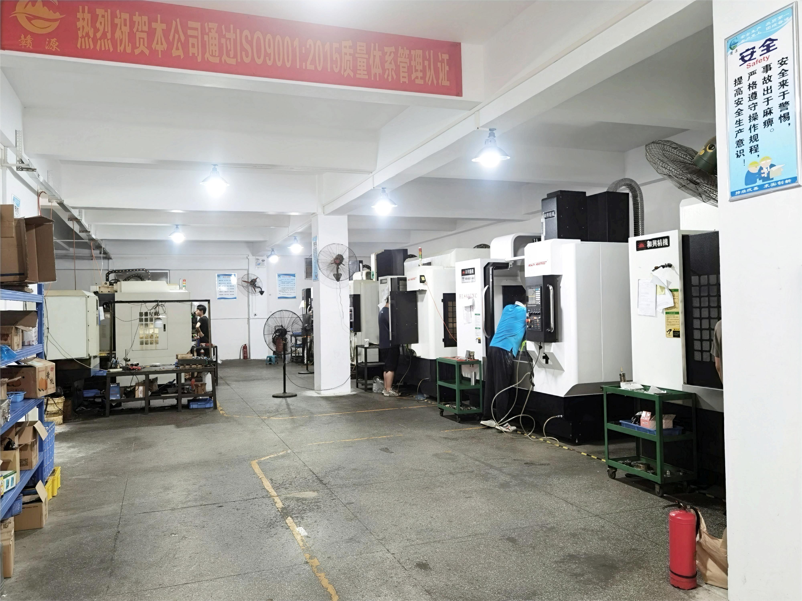
5-axis CNC workshop
Professional five-axis CNC external processing, 15 years of factory, more than 20 years of production and processing experience
1: Five-axis models include: precision 255 type \ 210 type five-axis table, the maximum diameter can be processed to 400MM, and the length can be processed to 300MM. Accuracy tolerance ±0.02MM. Suitable for the production and processing of mechanical parts. Production and processing of large parts and products.
2: Precision 170-type five-axis table, which can be processed to a maximum diameter of 200MM and a length of 200MM. It is a precision small five-axis, suitable for parts and product processing.
3: Multiple five-axis drilling and tapping machines and five-axis engraving and milling machines, with high speed, high precision and high speed. It is suitable for the production and processing of small products and hardware products.
赣源五金

Slide 5
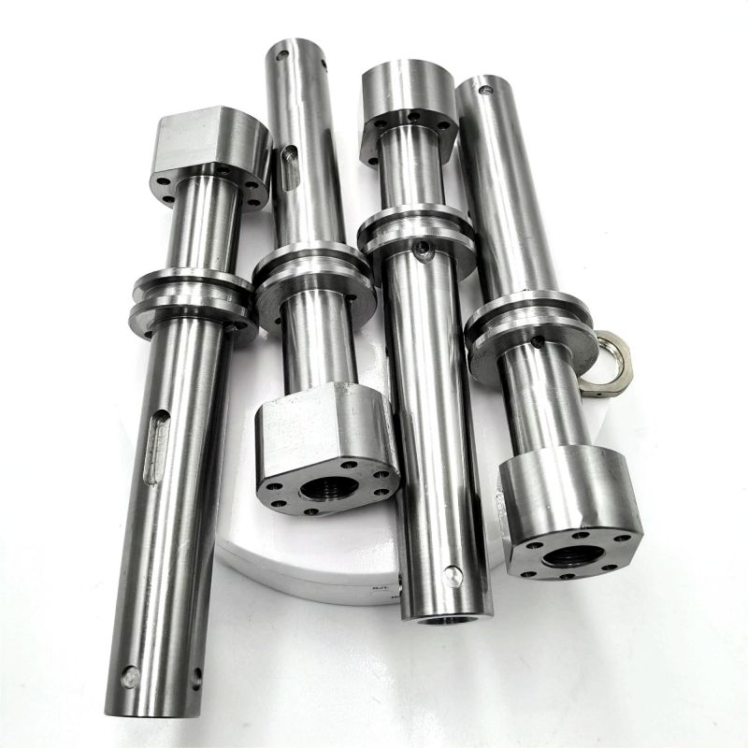
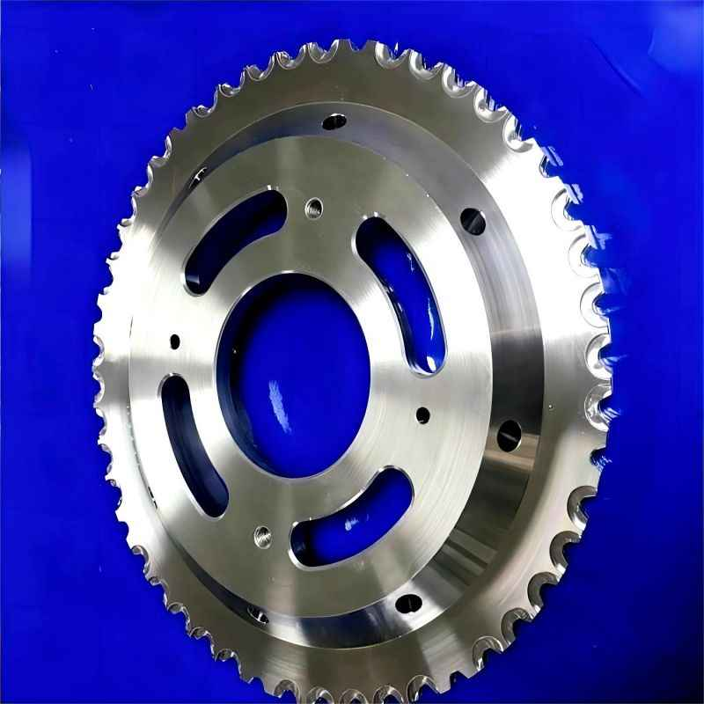
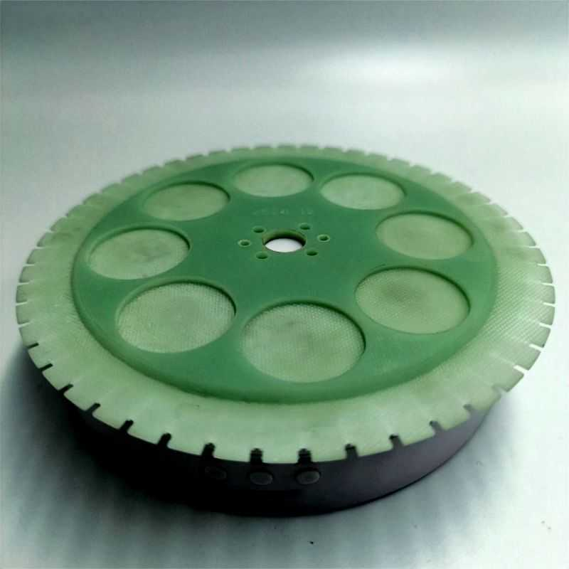
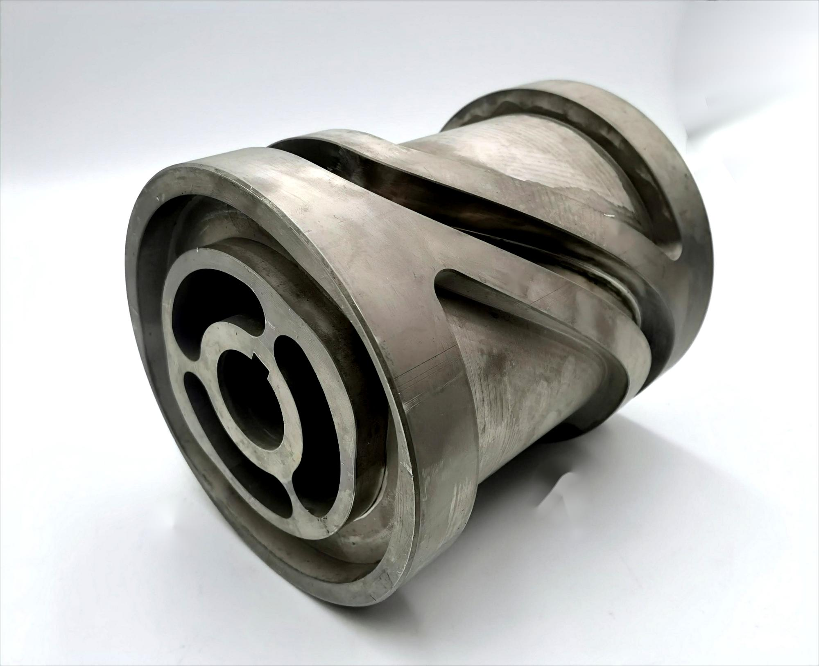
stainless steel shaft
mechanical gear
PCB puller wheel
mechanical cam

Slide 6
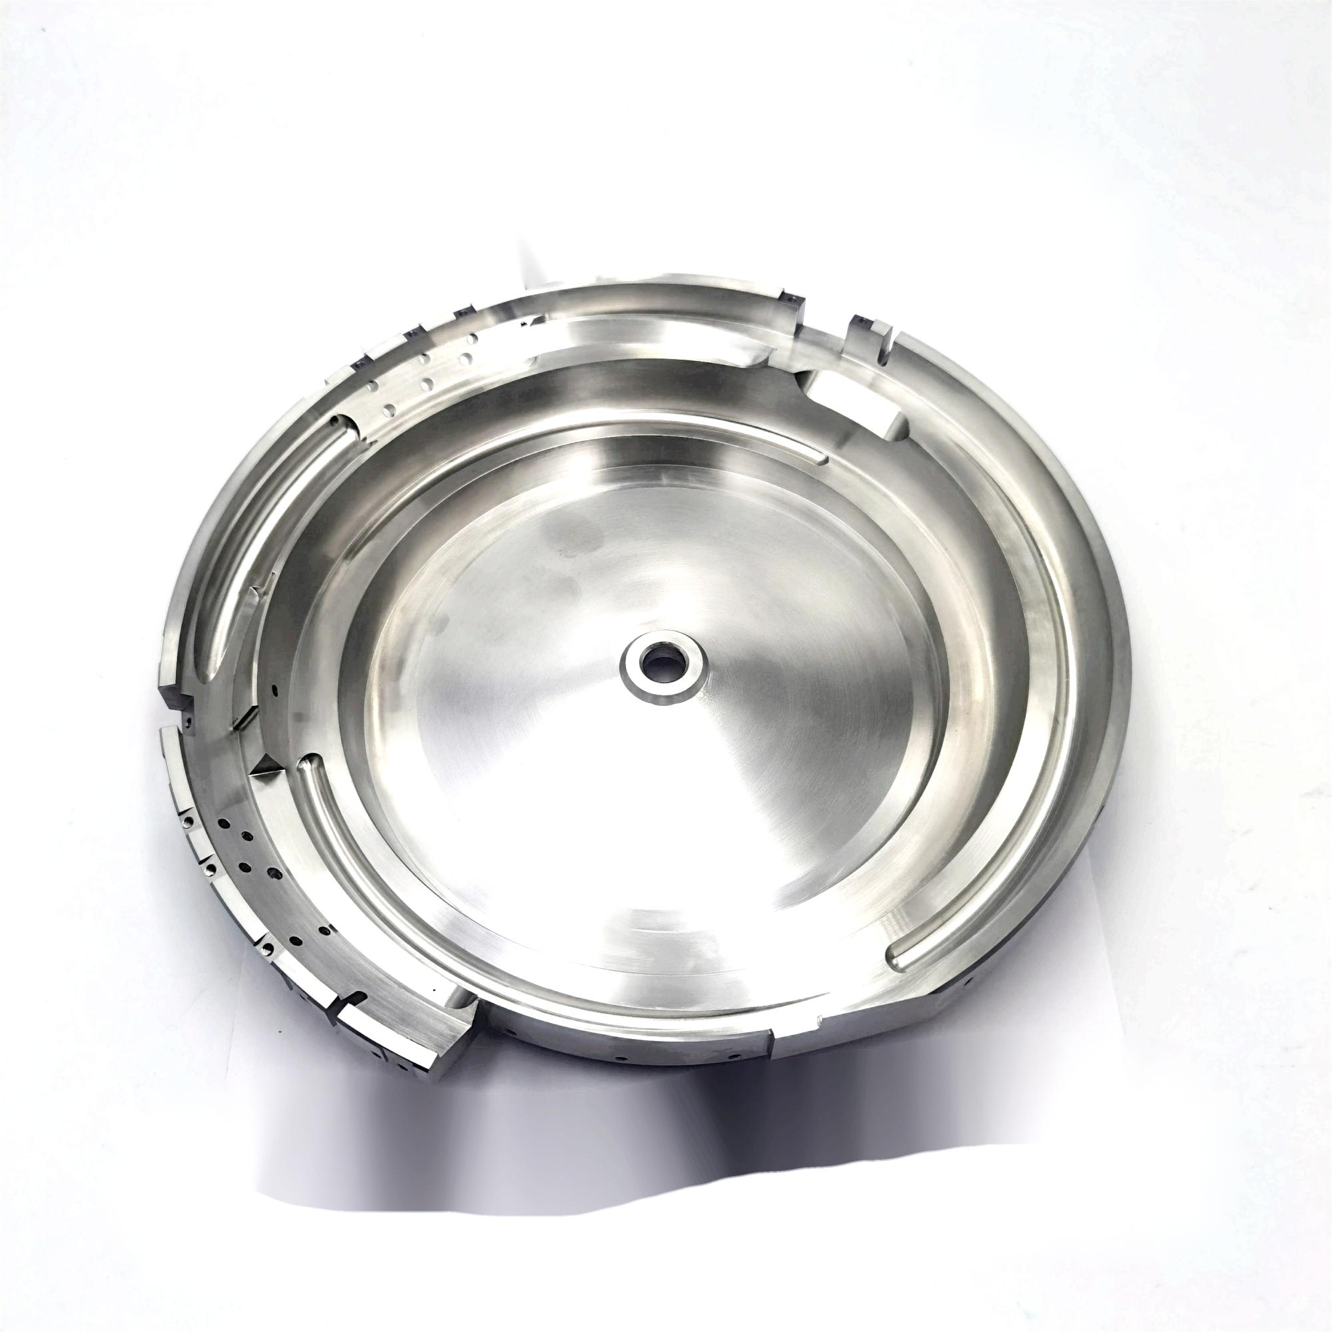
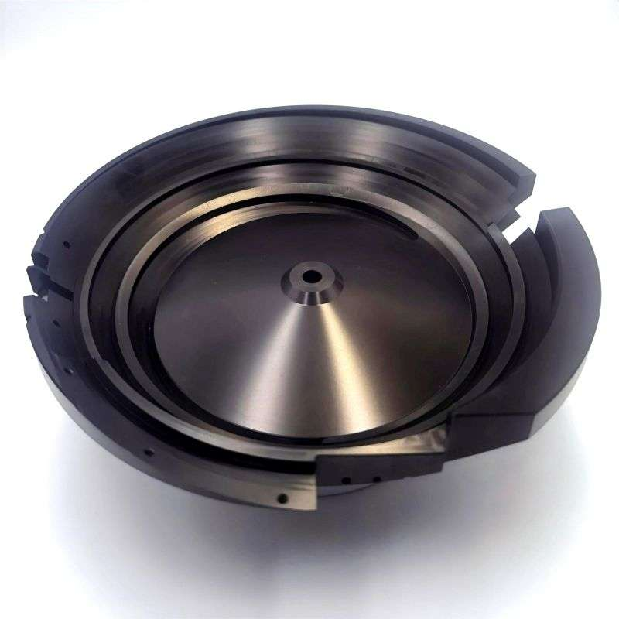
Vibrating Plate
SUS304 stainless steel vibrating plate
Vibrating plate is an auxiliary feeding equipment for automatic assembly or automatic processing machinery, also known as vibrating plate automatic feeder. It can arrange various small products in an orderly manner and adjust the posture of the products to achieve continuous feeding. Provide the correct assembly parts for automatic assembly equipment to complete a product, or cooperate with automatic processing machinery to complete the processing of the product.
Features: to achieve automation, reduce costs, improve production efficiency
Welcome to map to inquire and order, thank you!
Hard anodized aluminum alloy vibrating plate

Slide 7
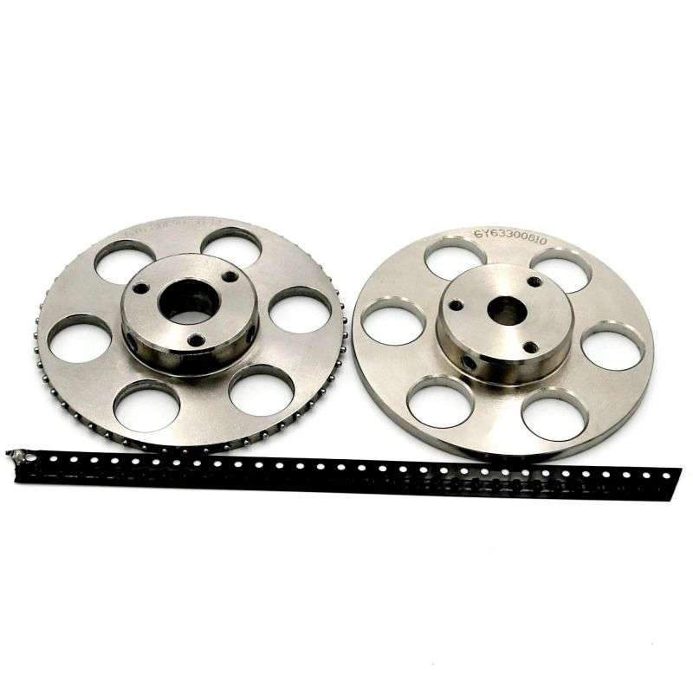
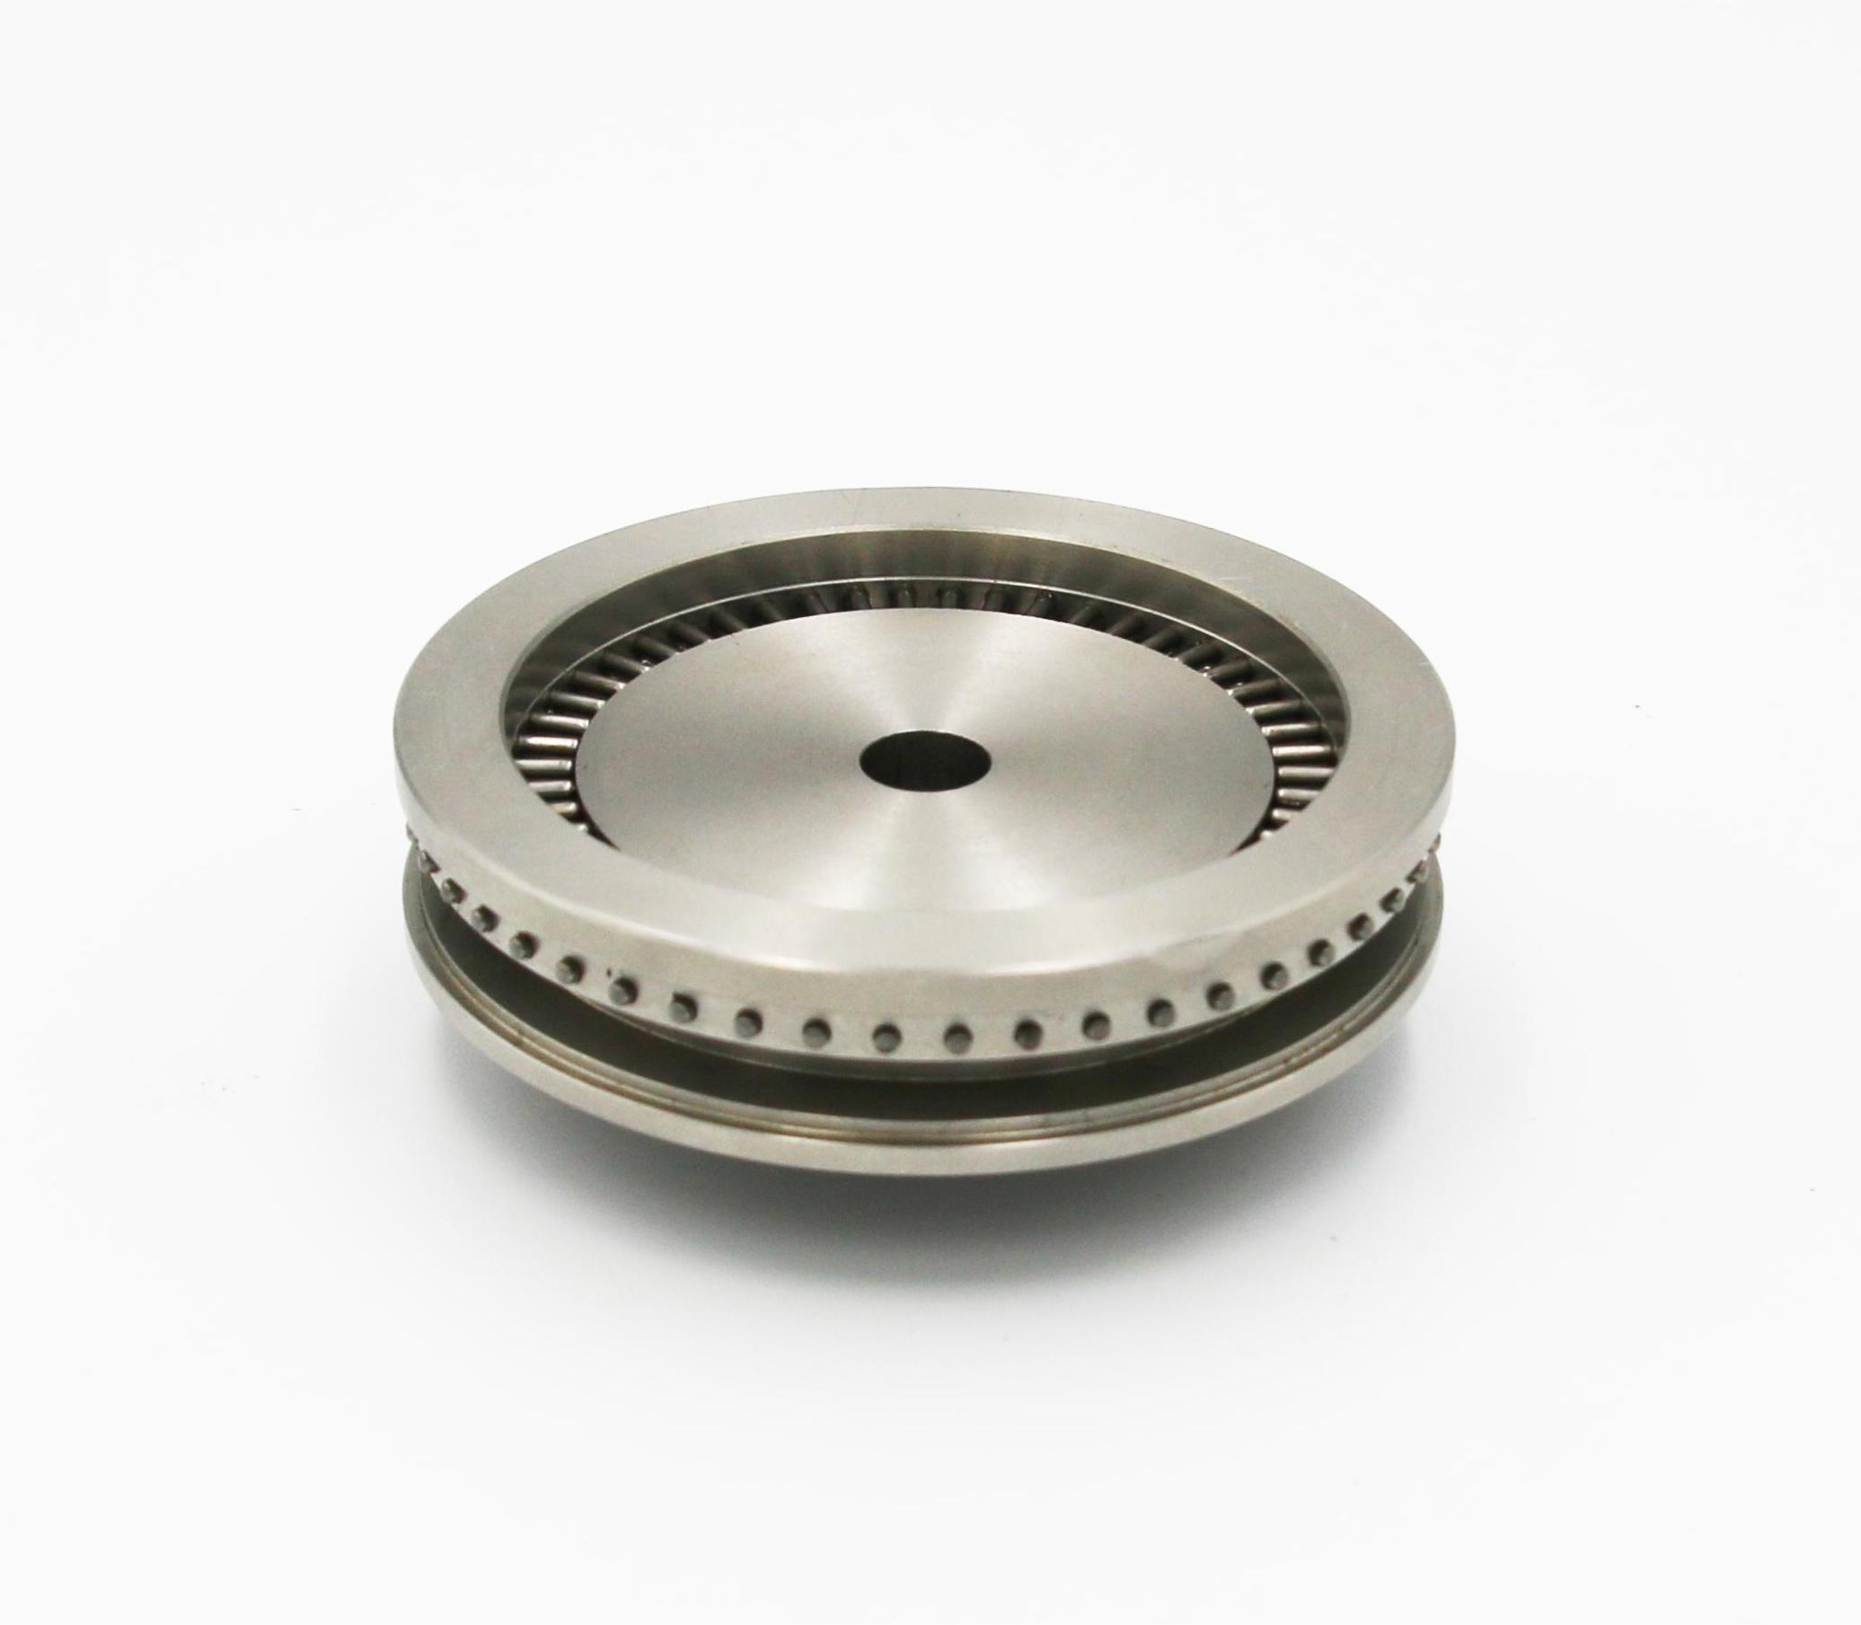
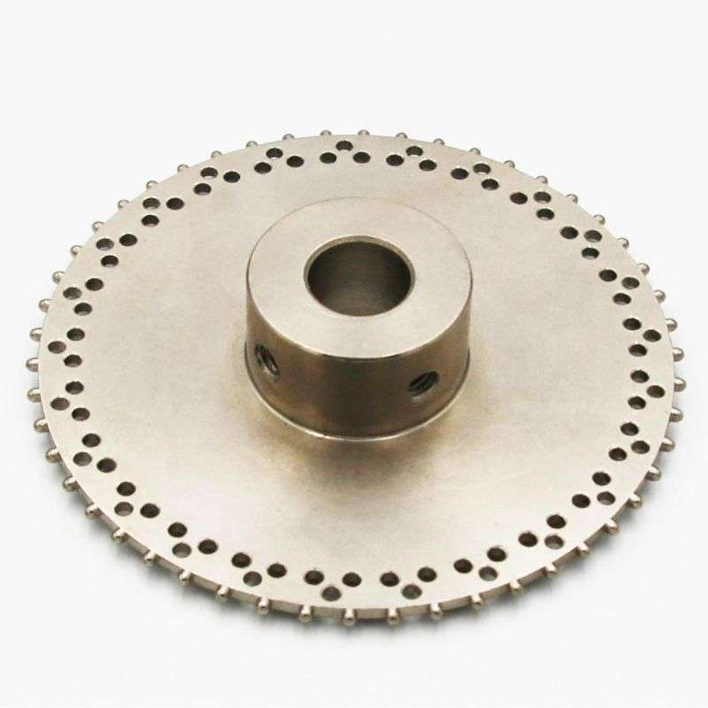
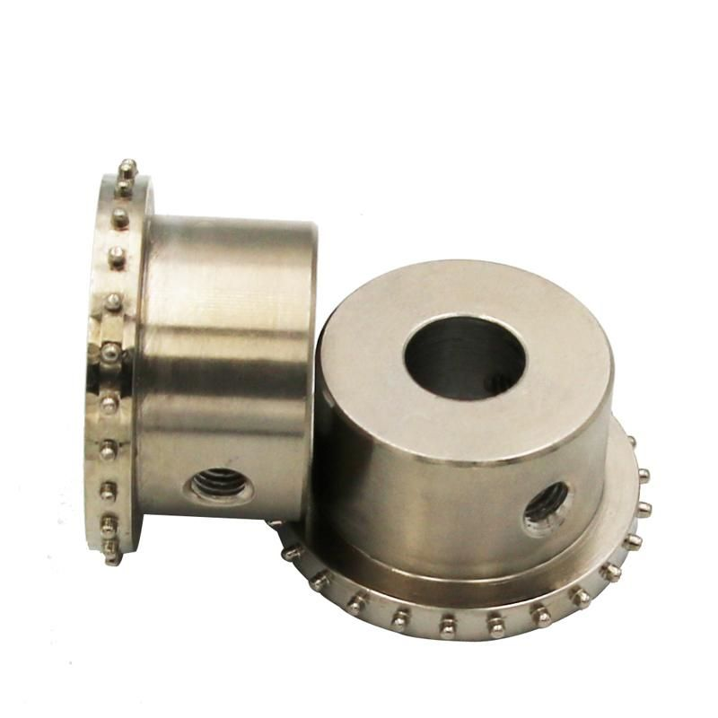
Non-standard customized production and wholesale integrated / pin-type ratchet pin wheel 50 teeth 30 teeth, 25 teeth, 40 teeth, 48 teeth
This is a pin wheel ratchet for tape carrier, packaging machine, SMD tape machine, placement machine, package measuring machine, plastic tape/paper tape/metal tape.
Tooth spacing: 4.0MM; Needle/nail size: 1.40---1.45MM
Tooth height: 1.0MM--1.3MM State: spherical/conical
Number of teeth: 50 teeth Inner hole: 8.0, 12.0, 10.0
Model: GY6320081050140, GY6330121050140, GY6320101050140, GY3150081525140, GY6040156048140

Slide 8
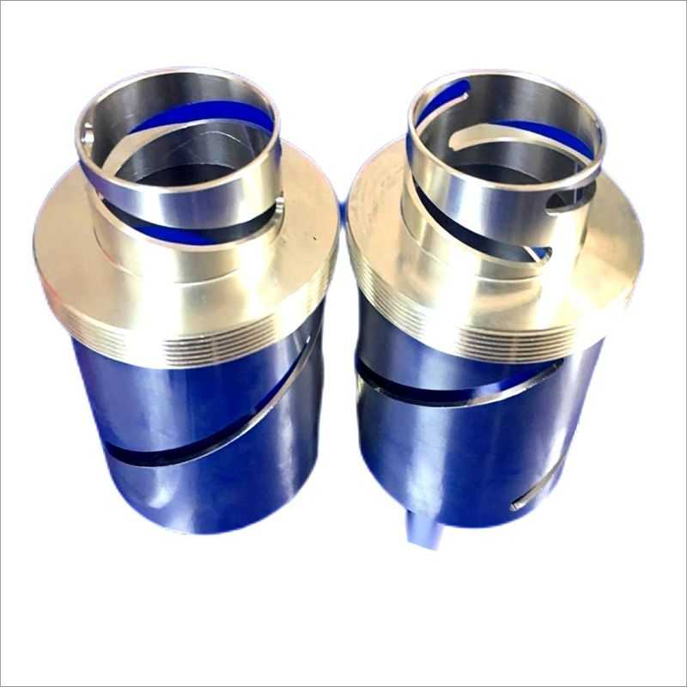
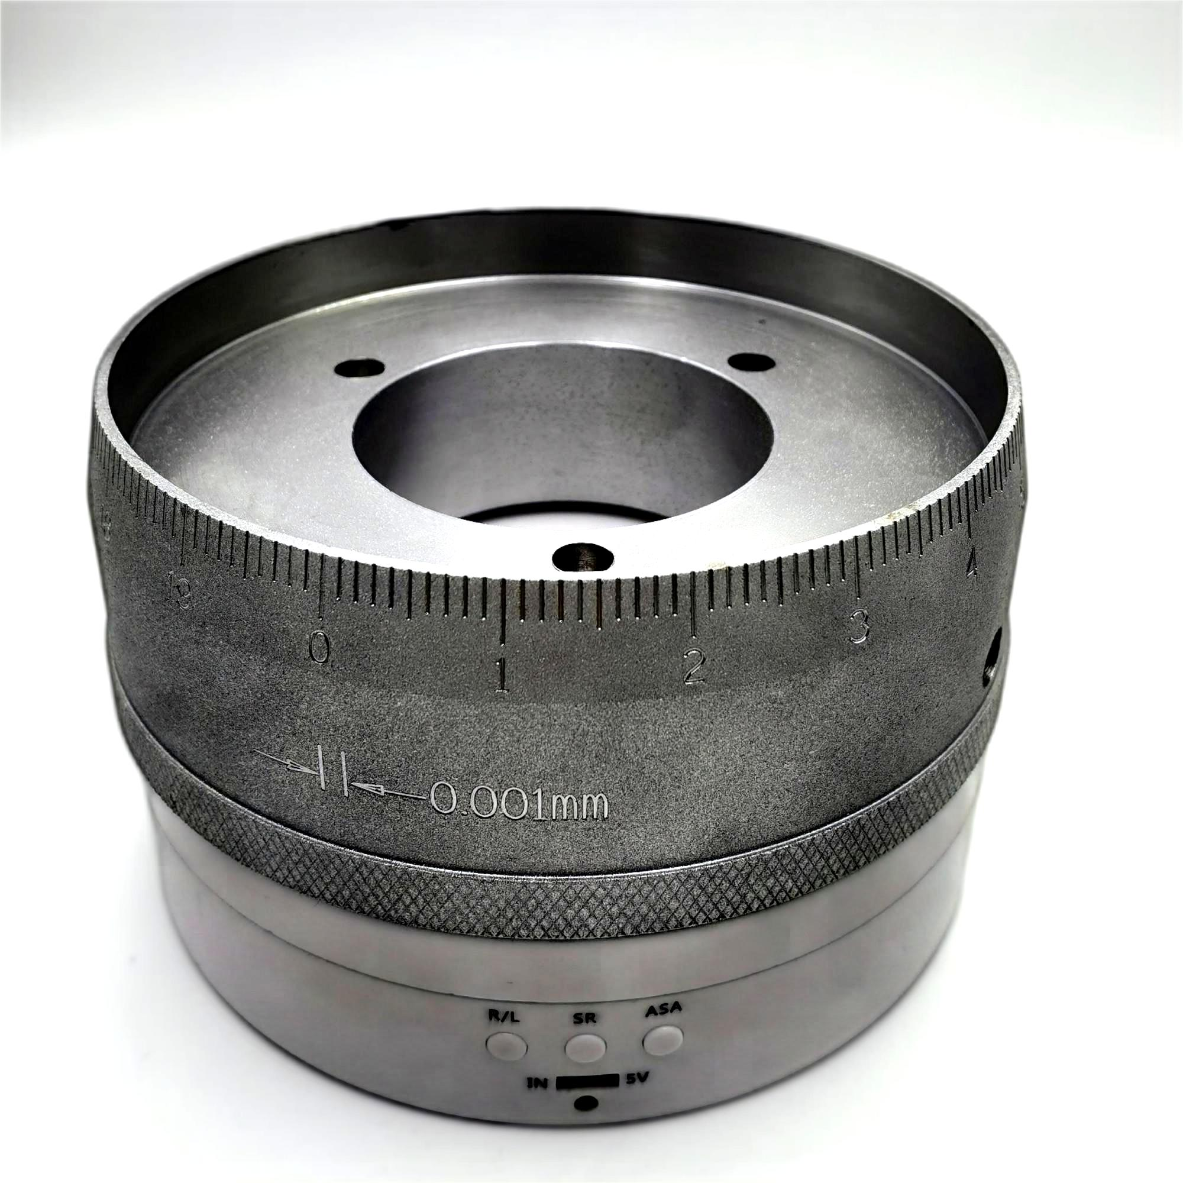
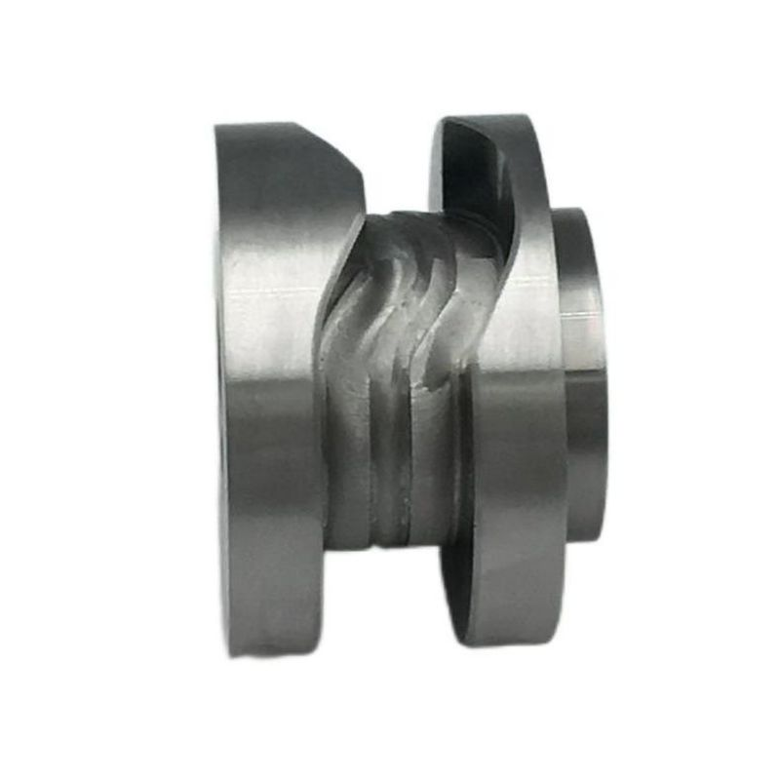
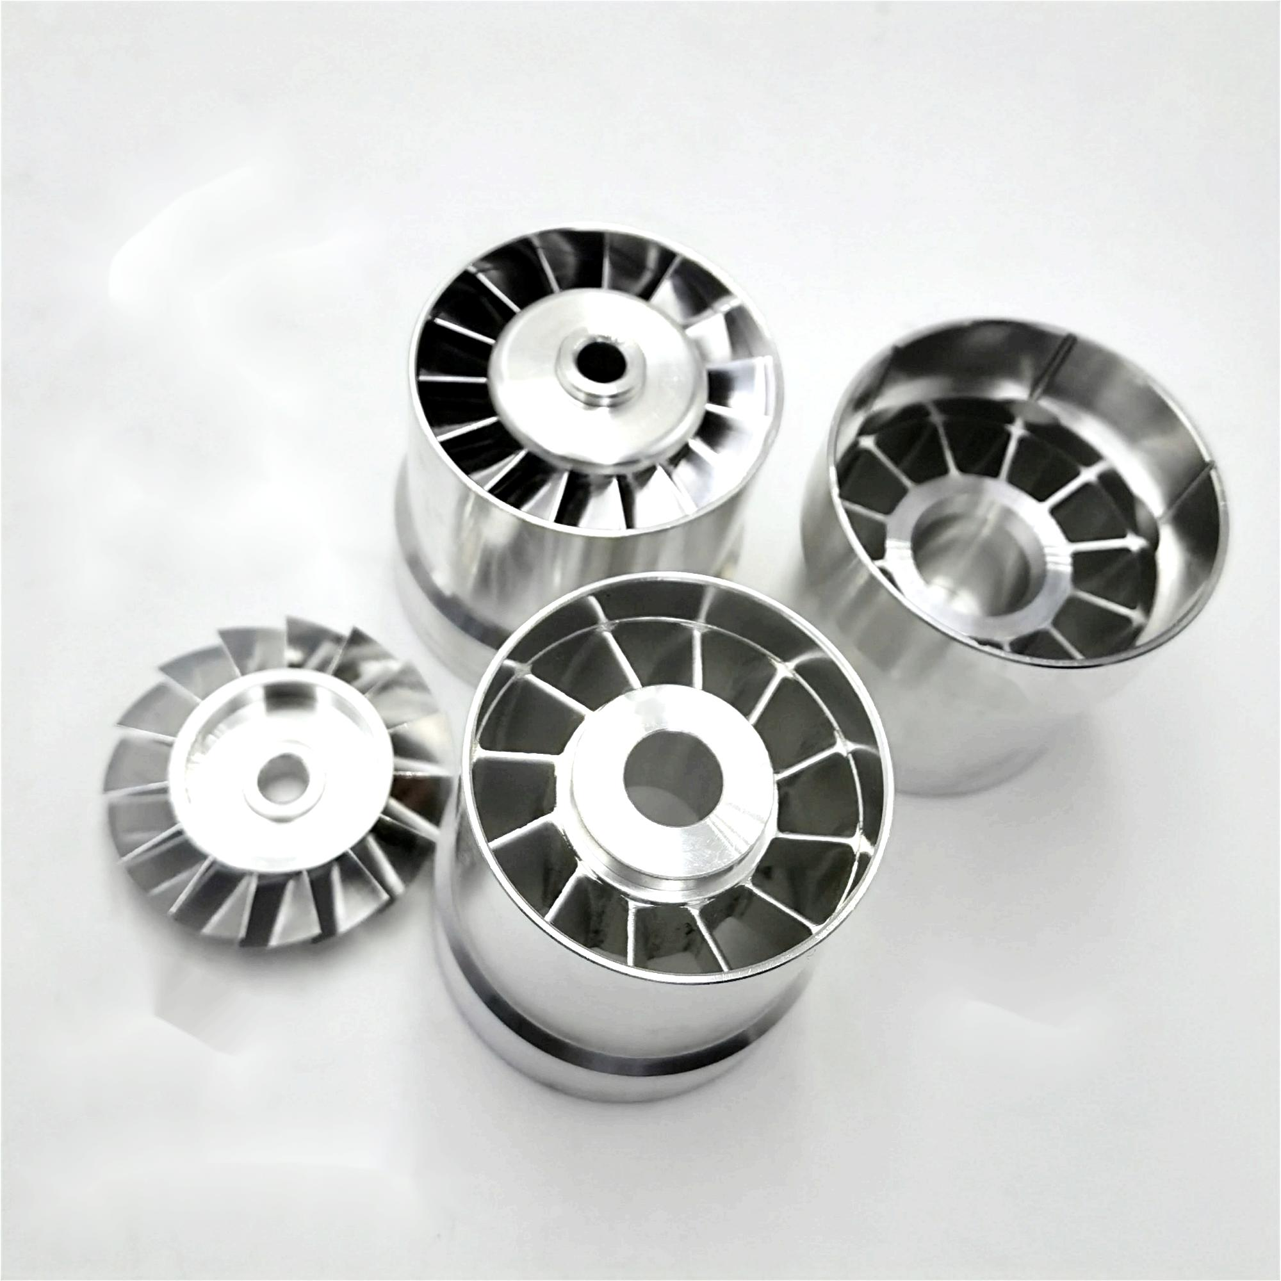
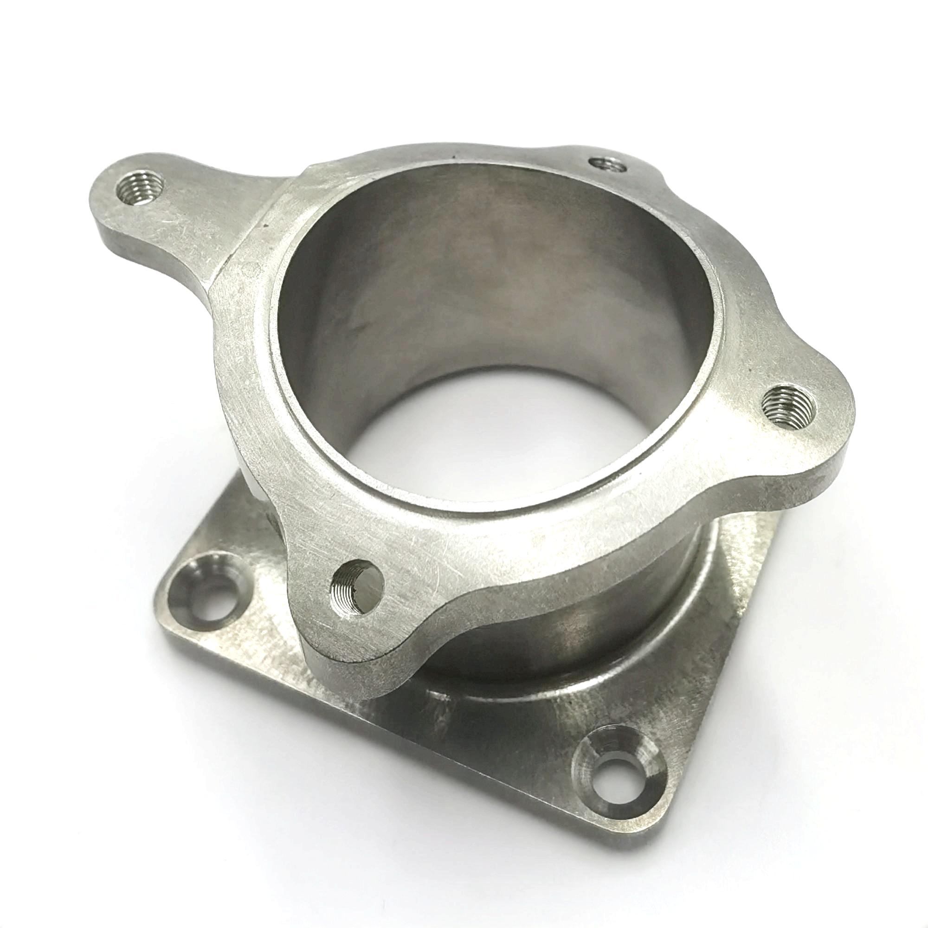
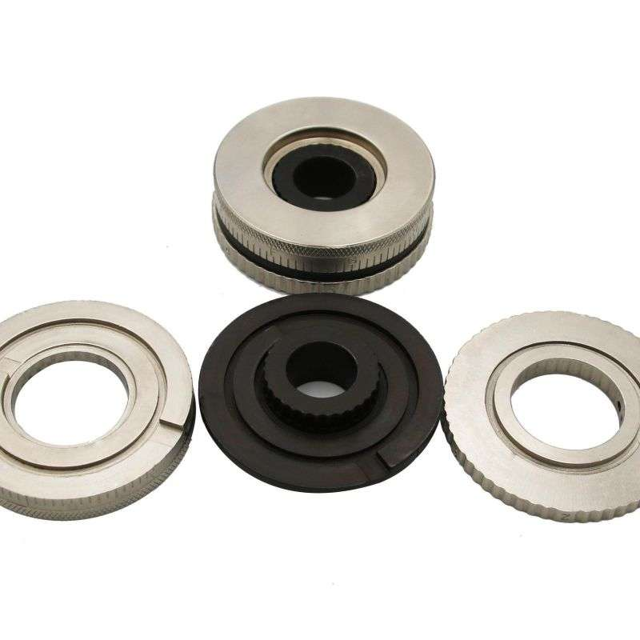
4-axis cam
It is processed by professional 4-axis CNC machining center, outer diameter: 40MM, groove width: 12MM, tolerance: +0.02MM
Trimming dial/
Numeric dial
Composed of three pieces, the outer diameter is 57MM, and the inner hole is 16MM. It is used for fine-tuning numbers, such as terminal machines and telescopes.
Professional 5-axis CNC machining, CNC lathe external processing

Slide 9
Thanks for watching
Welcome to call for consultation and production
Technical telephone: 13929256361 Mr. Liao
E---mail: ganyuancnc@163.com
Website: https://ganyuan.net
Q Q：362027810
Address: 1st Floor, Building A, No. 78, Yintong Road, Shuikou Industrial Zone, Dalang Town, Dongguan City, Guangdong Province

